Slide 1
Change Management
SE423: Software Project Management

Slide 2
Outline
Change Control
Software Maintenance
Other Aspects
Summary

Slide 3
Change Control

Slide 4
Software Change
Software change is inevitable
  New requirements emerge when the software is under development or being used
  The business environment changes
  Errors must be repaired, Risks mitigated
  New equipment must be accommodated
  The performance or reliability may have to be improved
A key problem for organizations is implementing and managing change to their current projects and legacy systems

Slide 5
Integrated Change Control
Integrated Change Control is a process concerned with project change requests
The process is carried out from project inception through completion
All changes must be carefully controlled to maintain the integrity and consistency of the project plan
  Change control encompasses review, evaluation, approval/rejection, and managing and coordinating approved changes

Slide 6
Integrated Change Control
Recognizes that projects will often require changes to the established project plan
All changes must be carefully controlled to maintain the integrity and consistency of the project plan
Integrated change control encompasses all aspects of change to the project:
  Reviewing and approving requested changes
  Managing the changes when they actually occur
  Controlling elements of the project management plan (scope, cost, budget, schedule, and quality) in response to changes
  Controlling changes to requirements, design, code and documentation.

Slide 7
Change or Configuration Control
Configuration Management Plan
Change & Version control
  Items:
    Code (source for product)
    Documents: requirements, design, test plans, user guides
    Plans and databases (MS project, etc.)
    Scripts for testing
    Scripts for infrastructure
    Software development plan and other process documents

Slide 8
Integrated Change Control
In some projects, the Integrated Change Control process includes a change control board (CCB)
The CCB is a formally chartered group responsible for reviewing, evaluating, approving, delaying, or rejecting changes to the project, and for recording and communicating such decisions
Note that changes have a potentially greater impact in CPM scheduling:
  Changes on the critical path have greatest impact while those off the critical path have less
Changes in CCM scheduling require adjustments to buffers
  The same responses to change are needed, but the impact to the schedule may be less severe than in CPM

Slide 9
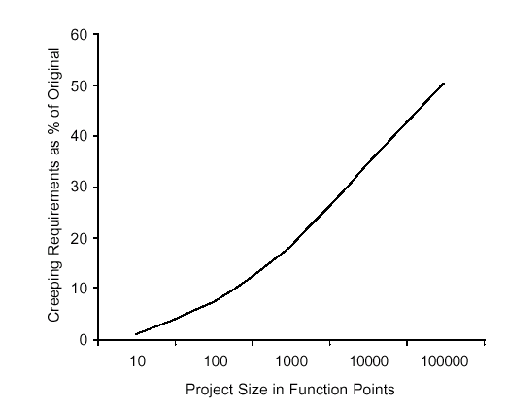
Change Control
Average project has 25% requirements change
Overly detailed specs. or prolonged requirements phase are not the answer
Sources of change
Change control is a process
Change Control Board (CCB)
  Structure, process, triage

Slide 10
Control the Change – I
Need for change is recognized
Change request is submitted as a “request for change” (RFC) or engineering change order (ECO)
Developer or PM team evaluates: impact and desirability
Change report is generated
Change control authority (CCB) makes a decision to either:
  Deny request.
    Change request is denied
    User is informed
  Proceed
If change is approved:
Request is queued for action. ECO (Engineering Change Order) is generated.
Individuals assigned to configuration objects.
Objects checked out and change made.
Change audited.
Baseline established.
If it is a Software Configuration Item (SCI)
  Perform SQA and testing activities
Check-in the changed objects

Slide 11
Control the Change – II
For Software Configuration Items (SCI)
Promote SCI for inclusion in next release
Rebuild appropriate version
  Include all changes in release
  Review/audit the change
  Perform Verification and Validation [testing activities]
Distribute new version

Slide 12
Control the Change – III
Use a change management system (COTS) and a change tracking system.
Ideal if they are integrated: aka Comprehensive Software Change Management
  SCM (Source code management)
  Issue/defect tracking software

Slide 13
Agile Perspective (Integrated change control)
The agile change control process is not controlled by a change review board and the project manager
  Product changes are owned and managed by the customer
  Process changes are owned by the team
  The project manager facilitates collaborative discussion of changes between the customer and the team
Integrated Change Control maps to ‘continuous backlog management’ in an agile project

Slide 14
Integrated Change Control Comparison
Feature | Plan-driven Methodologies | Adaptive Methodologies
Change Control Approach | Formal and structured approach | Informal and flexible approach
Change Management Plan | Well-defined and documented plan | Limited or no plan
Change Control Board (CCB) | Formal CCB with defined roles and responsibilities | Informal CCB with flexible roles and responsibilities
Change Request Process | Formal process with strict change request procedures | Informal process with flexible change request procedures
Change Impact Analysis | Thorough and detailed analysis of change impact | Limited or no analysis of change impact
Change Implementation | Changes are implemented after approval from CCB | Changes are implemented quickly and frequently
Documented Changes | Changes are well-documented and tracked | Changes may not be documented or tracked
Change Communication | Formal and structured communication plan | Informal and flexible communication plan
Project Management Approach | Emphasizes predictability and control | Emphasizes flexibility and adaptability
Applicability | Best suited for projects with well-defined requirements and a stable environment | Best suited for projects with changing requirements and an uncertain environment

Slide 15
Change During Development
Sometimes change occurs during development that necessitates changes in scope
  Approval of CCB (Change Control Board) and
  Requires extensive planning
  May require more time/resources (project triangle)
Plan-driven methodologies may or may not have this built in (i.e. Spiral) or may be specifically built to resist change (i.e. Waterfall)
Agile Methodologies embrace change
  Scrum allows for change to the Product Backlog at any time, but manages risk by freezing the current Sprint Backlog
Stakeholder Communication IS KEY

Slide 16
Software Change Strategies
Software maintenance
  Changes are made in response to changed requirements but the fundamental software structure is stable
Architectural transformation
  The architecture of the system is modified generally from a centralized architecture to a distributed architecture
Software re-engineering
  No new functionality is added to the system but it is restructured and reorganized to facilitate future changes
These strategies may be applied separately or together

Slide 17
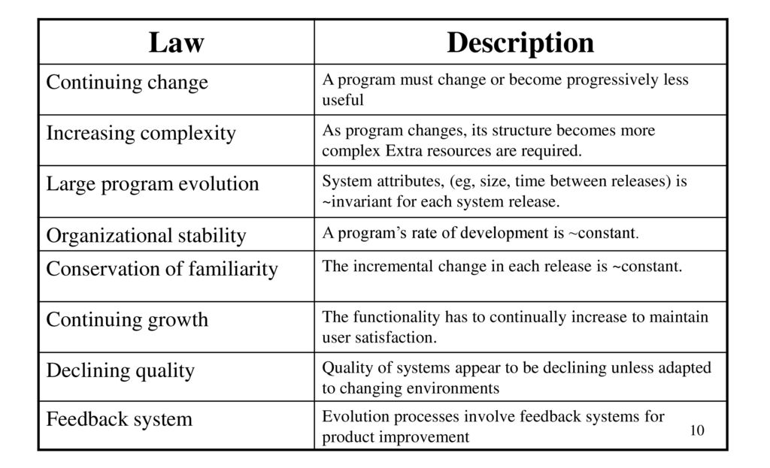
Lehman’s Laws

Slide 18
Applicability of Lehman’s Laws
This has not yet been established
They are generally applicable to large, tailored systems developed by large organizations
It is not clear how they should be modified for
  Shrink-wrapped software products
  Systems that incorporate a significant number of COTS components
  Small organizations
  Medium sized systems

Slide 19
Software Maintenance

Slide 20
Software Maintenance
Modifying a program after it has been put into use
Maintenance does not normally involve major changes to the system’s architecture
Changes are implemented by modifying existing components and adding new components to the system

Slide 21
Maintenance is Inventible
The system requirements are likely to change while the system is being developed because the environment is changing. Therefore a delivered system won't meet its requirements!
Systems are tightly coupled with their environment. When a system is installed in an environment it changes that environment and therefore changes the system requirements.
Systems MUST be maintained therefore if they are to remain useful in an environment

Slide 22
Types of Maintenance
Maintenance to repair software faults
  Changing a system to correct deficiencies in the way meets its requirements (Corrective Maintenance)
Maintenance to adapt software to a different operating environment
  Changing a system so that it operates in a different environment (computer, OS, etc.) from its initial implementation (Adaptive Maintenance)
Maintenance to add to or modify the system’s functionality
  Modifying the system to satisfy new requirements (Perfective Maintenance)

Slide 23
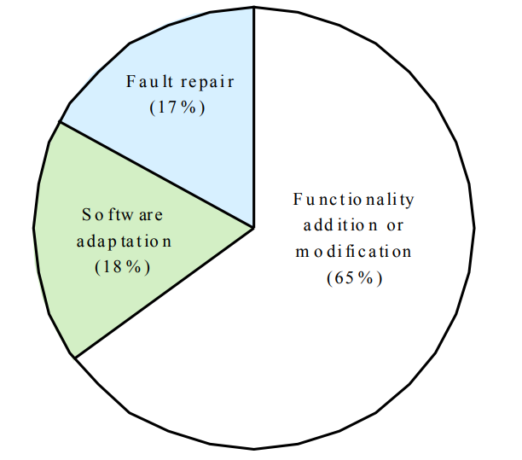
Distribution of Maintenance Efforts

Slide 24
Maintenance Cost
Usually greater than development costs (2* to 100* depending on the application)
Affected by both technical and non-technical factors
Increases as software is maintained. Maintenance corrupts the software structure so makes further maintenance more difficult.
Ageing software can have high support costs (e.g. old languages, compilers etc.)

Slide 25
Maintenance Cost Factors
Team stability
  Maintenance costs are reduced if the same staff are involved with them for some time
Contractual responsibility
  The developers of a system may have no contractual responsibility for maintenance so there is no incentive to design for future change
Staff skills
  Maintenance staff are often inexperienced and have limited domain knowledge
Program age and structure
  As programs age, their structure is degraded and they become harder to understand and change

Slide 26
Evolutionary Software
Rather than think of separate development and maintenance phases, evolutionary software is software that is designed so that it can continuously evolve throughout its lifetime
YES, but how/much?

Slide 27
Maintenance Prediction
Maintenance prediction is concerned with assessing which parts of the system may cause problems and have high maintenance costs
  Change acceptance depends on the maintainability of the components affected by the change
  Implementing changes degrades the system and reduces its maintainability
  Maintenance costs depend on the number of changes and costs of change depend on maintainability

Slide 28
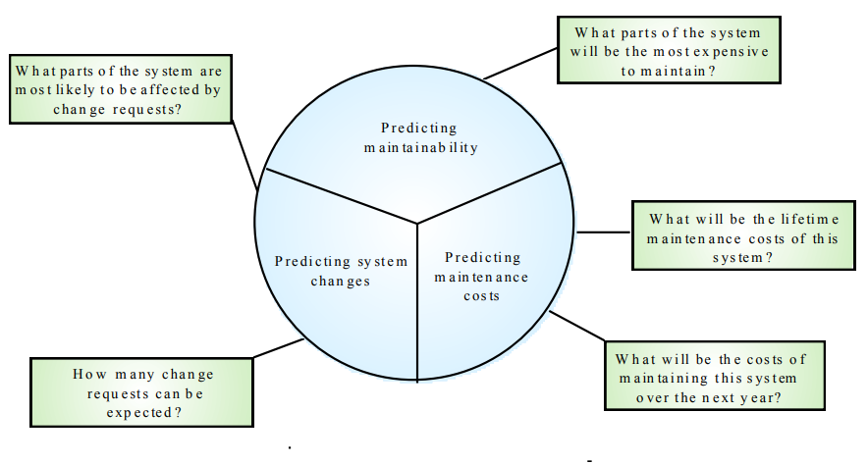
Maintenance Prediction

Slide 29
Change Prediction
Predicting the number of changes requires an understanding of the relationships between a system and its environment
Tightly coupled systems require changes whenever the environment is changed
Factors influencing this relationship are
  Number and complexity of system interfaces
  Number of inherently volatile system requirements
  The business processes where the system is used

Slide 30
Complexity Metrics
Predictions of maintainability can be made by assessing the complexity of system components
Studies have shown that most maintenance effort is spent on a relatively small number of system components
Complexity depends on
  Complexity of control structures
  Complexity of data structures
  Procedure and module size

Slide 31
Process Metrics
Process measurements may be used to assess maintainability
  Number of requests for corrective maintenance
  Average time required for impact analysis
  Average time taken to implement a change request
  Number of outstanding change requests
If any or all of these is increasing, this may indicate a decline in maintainability

Slide 32
Architecture Evolution
There is a need to convert many legacy systems from a centralised architecture to a client-server architecture
Change drivers
  Hardware costs. Servers are cheaper than mainframes
  User interface expectations. Users expect graphical user interfaces (CLI->GUI)
  Distributed access to systems. Users wish to access the system from different, geographically separated, computers

Slide 33
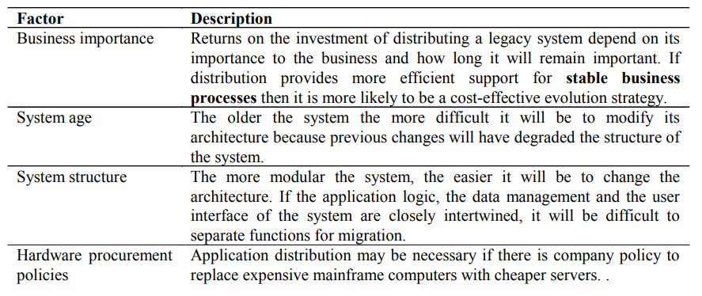
Distribution Factors

Slide 34
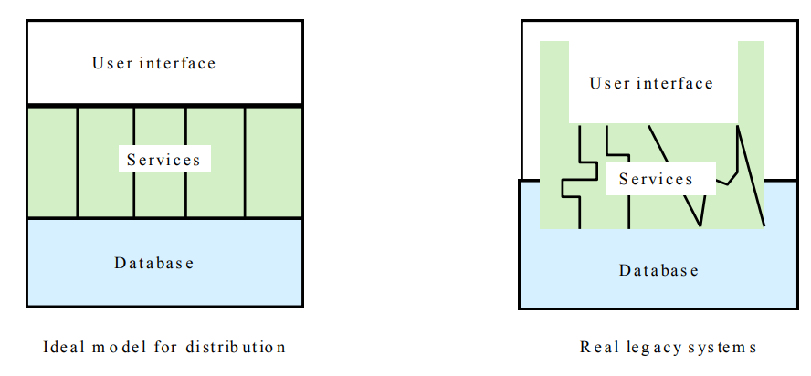
Legacy System Structure
Ideally, for distribution, there should be a clear separation between the user interface, the system services and the system data management
In practice, these are usually intermingled in older legacy systems

Slide 35
Key Points
The costs of software change usually exceed the costs of software development
Factors influencing maintenance costs include staff stability, the nature of the development contract, skill shortages and degraded system structure
Architectural evolution is concerned with evolving centralized to distributed architectures
A distributed user interface can be supported using screen management middleware

Slide 36
Other Aspects

Slide 37
Other Aspects
Roll-Out
  Release Check-List
Training
  More than just end-users
    Users, systems ops, maintenance developers, sales
Documentation
    Many types: End-user, sales & marketing, operations, design
Migration
  Moving users from existing system to your new one
Maintenance and Support
We’ll discuss each of these …

Slide 38
Rollout
Create a “Release Checklist”
  Avoid activities falling through the cracks
  Activities by Group:
    Engineering, QA, Documentation, Operations
  Possibly sign-off signatures
Roll-out: Must have a plan for the process
  Often on a given day (ex: a Sat.)
  Must be a very detailed plan

Slide 39
Shipping Details
Packaging (if commercial product)
Marketing collateral
Security mechanisms (if commercial product)
Licensing
  Plan
  Mechanism

Slide 40
Installation
Scripts
Uninstall (if not Web-based)
If you need to install your software (as on PCs):
  Don’t underestimate:
    Time this takes to develop
    Importance of a “first impression”
Or, if “custom” software you’re reselling
  Installation at site is often a “mini-project”

Slide 41
Training
Often more than just end-users
  Users
  Sales & Marketing staff
  System operators
  Maintenance engineers (possibly)
  Sales engineers (possibly)
  (Technical) Support staff

Slide 42
Documentation
Must be ready by ship-date
Final user documentation
  On-line help
Updates to other
  Operations documentation
  Development documentation
  Sales and marketing material
  Web site
  Test reports
  Release notes

Slide 43
Migration
Migration is the process of moving from the old application/system to the new
Migration Plan
Back-out Plan
Data Conversion

Slide 44
Migration Plan
Includes
  Description of environment (computers, DBs, interfaces)
  Description of existing data needed
  Description of operational constraints (ex: when can we move to the new system? Weekends only? Last week of month only?)
  List of affected organizations and contacts
  Plan of steps to be taken
Does it require a service interruption?
  If so, when does this happen? A weekend?
Training?
Is there a help-desk?
  If so, do they have “scripts” or new material?

Slide 45
Migration Strategies
Communication with customers is crucial
  Importance of 2-way communication
  What is happening, when, and why
  “Why” should remind them of the benefits
  Not too much detail or too little
  Where do customers go for more information?
Minimize intrusiveness
Find-out about customer’s key dates
  When does the system absolutely need to be stable?
  Know about their important deadline dates
  They must buy-into the approach!

Slide 46
Migration Strategies
Considerations:
  Level of business disruption
  Degree of latitude in “production” date
  How much internal opposition to system is there?
    If higher, perhaps a longer ‘adjustment’ period
  Your comfort level of system quality
    If questionable, may want to mitigate risk

Slide 47
Migration Strategies
Flash-Cut migration
  Straight-move from old system to new
  Immediate Replacement
    Fastest approach
    Still want a back-out plan
    Requires strong planning and testing
  Parallel Operation
    Mitigates risk
    Parallel to either existing manual or system process
    Cut occurs once new system “burned-in”
Staged migration
    Replace one part of existing system at a time

Slide 48
Flash-Cut
Immediate Replacement
  Ex: new corporate-wide calendar system
Requires very careful planning & testing
Still try to get some users to “try” it first if possible
Develop a back-out plan

Slide 49
Cutover
Criteria: What conditions must be met prior?
Responsibility: Who decides?
Operations: Who ‘owns’ it once it’s live?
Rehearsals: Sometimes used.

Slide 50
Back-Out Plan
Especially important for “conversions”
  Customers already have expectations and needs as defined by their existing system
  Must be able to restore customer’s service ASAP
May mean running both simultaneously “just in case”
Leave it in place for awhile (more than a day!)
When to fall-back?
  Mgmt: sooner, Tech: one-more-fix
  Set a time limit (ex: 3 hours of start)
Data recovery and migration back to old system

Slide 51
Data Conversion
Most systems need this step
Most PMs forget this
Impacts both completely new and replacement systems
The “data” often more valuable than the “system”
Data Conversion Areas
Data Sources:
  Where does it come from?
  Do you need to modify data on the way in?
  Is it accurate?
Process Controls:
  Does it happen all at once?
  How do you guarantee it’s been done correctly?
Completion:
  How do you handle any ‘exceptions’?
  Do you make backups? Can you restart?

Slide 52
Parallel Operation
Multiple variations of this method
An “adoption” period
  See telephone industry with new area codes
  Both work for a period of time
Strategies
  Avoid flash-cuts if possible
    Start with test subjects

Slide 53
Concluding Software Projects
Seems simple, often isn’t
Potential Issues
  Last-minute change requests
    “One more feature”
  Disputes of fulfillment of all requirements
    Often “interpretation” issues
  Keeping the team motivated
  Difficult transition to maintenance

Slide 54
Maintenance Phase
Need a support plan and a maintenance plan [should be part of project plan]
The “No respect” phase
Less “glamorous”
  Lack of enthusiasm
Pressure to make fixes quickly
  For “production” problems
Software can become “hacked” “patchwork” over time
Finding a support & test platform can be difficult
  Often the forgotten child until fixes are needed

Slide 55
Maintenance Phase
Compare to hardware maintenance
  Not to keep state same; but changes to state
  Fixes and enhancements
Configuration control is very important
  Fixing the “right” version; tracking branches
Project management not always carried over
Smaller team
  Often not a ‘dedicated team’
  Drawn from developers with other main tasks

Slide 56
Maintenance Phase
Contracts, remember those?
  Always consider the maintenance phase here
  Often via a “labor hours” contract
    Time & materials in a “direct” scenario
  Otherwise via “maintenance contract”
    Percentage of software license fee
    Ex: 20% of original cost per year
Corp. budget if internal/IS projects
  Often annual/monthly “maintenance” allocations

Slide 57
Project in Trouble
“What if the project cannot meet the schedule?”
Level with the sponsor
Move some features/requirements to a second phase
Use Resource Leveling Techniques
  Fast tracking – two activities in parallel
  Activity shifting – Move start/end dates forward or backward
  Activity splitting – Break an activity into two or more pieces
  Activity stretching – Use less of a given resource continuously
  Resource substitution – Assign a different resource
  Allocating overtime – Work resources longer
Re-evaluate tasks: effort and need

Slide 58
Project Recovery
How to save a “drowning project”
3 Approaches
  Cut the size of the software
  Increase process productivity
  Slip the schedule, proceed with damage control
Opportunity for decisive leadership action
Not a time to ‘just cut corners’
  Be realistic (not foolish)
Timing: politically important
  Not too early, not “too” late

Slide 59
Project Recovery
First Steps
  Assess situation
    Is there a hard deadline, what’s negotiable, etc.
  Don’t do what’s been done already
  Ask team what needs to be done
People Steps
  Morale; focus; re-assign
    Restore morale
      Sacrifice a sacred cow [See note]
        Dress code, off-site, catered meals, etc.
      Cleanup personnel problems
    Focus people’s time
      Remove non-essential work
    Reassign tasks and responsibilities
Notes:
Sacrifice a sacred cow
This really does sound like a manifestation of the Hawthorne Effect - it's a short duration change to the worker environment, it enhances productivity because the worker is 'getting something special' - and since it's happening during a crisis the short duration of the effect works well within the scenario.
"...But Mayo says it is to do with the fact that the workers felt better in the situation, because of the sympathy and interest of the observers. He does say that this experiment is about testing overall effect, not testing factors separately. He also discusses it not really as an experimenter effect but as a management effect: how management can make workers perform differently because they feel differently. A lot to do with feeling free, not feeling supervised but more in control as a group. The experimental manipulations were important in convincing the workers to feel this way: that conditions were really different. The experiment was repeated with similar effects on mica splitting workers..."
In any event, hoisting the jolly roger might be going a bit too far (for you Mac aficionados out there).

Slide 60
Project Recovery
Process Steps
  Fix classic mistakes
    Inadequate design, shortchanged activities, etc.?
  Create “Miniature Milestones”
    Small (in day(s)), binary, exhaustive
    Boosts morale: getting things done!
  Track progress meticulously
  Recalibrate after a short time
  Manage risk painstakingly

Slide 61
Project Recovery
Product Steps
  Stabilize the requirements
  Raise the bar on change requests
  Trim the feature set (see feature set control)
    Determine priorities, cut the low ones
  “Take out the garbage”
    Find error-prone modules; re-design
  Get to a known, stable state & build from there

Slide 62
Feature Set Control
Minimal Specification
Requirements Scrubbing
  unnecessary or overly complex requirements to be removed.
Versioned Development
Effective Change Control
Feature Cuts

Slide 63
Summary
The software change management process is the process of managing changes to the project scope, schedule, or budget.
The change management process starts with change identification, where a change request is submitted and recorded.
The change is then evaluated to determine its impact on the project, including the scope, schedule, budget, and quality.
If the change is approved, it is implemented and integrated into the project plan.

Slide 64
Summary
Finally, the change is monitored and controlled to ensure that it does not have any negative impacts on the project.
Change management techniques include developing a change management plan, establishing a change control board, and communicating changes to stakeholders.
Change management plans should include the change management process, roles and responsibilities, communication and reporting, and change control procedures.

Slide 65
Summary
A change control board is responsible for evaluating and approving changes, and ensuring that changes are managed effectively.
Communication is critical to change management, and project managers should communicate changes clearly and effectively to stakeholders.
Effective change management can help ensure that changes are managed in a controlled and structured manner, minimizing the risk of negative impacts on the project.

